Slide 1

Deep Learning and IVF
First Rotation Project @ Hajirasouliha Lab

Slide 2
Overview
Objectives
Use Deep Learning to classify blastocytes into euploidy, aneuploidy, complex aneuploidy, and mutant cells through imaging to explore non-invasive/unbiased methods to select best cells for IVF

Slide 3
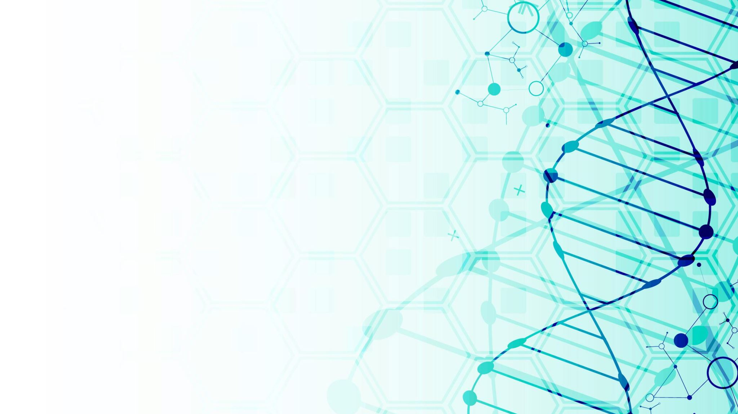
Contents
Data
Preprocessing
Model Choice
Performance

Slide 4
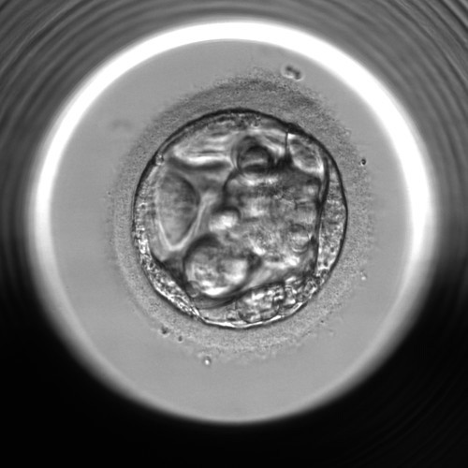
Data (size: ~10k)
Metadata
Patient Age
Egg Date
Time stamps
Size of XXX
Scores from multiple Embryologists Groups
Different Metrics
Image
Blastocyte

Slide 5
Data Exploration (Metadata)
Class Distribution
Biggest Chunk: EUP, CxA
Most Important Metadata Feature is Age of the patient
Both by T-test (****: p-value < 10⁻²⁰) and by XGBoost feature importance
Can Achieve 50% accuracy based on XGBoost w/ Metadata Only

Slide 6
Setting Baseline Models with Patient Age
Thresholds at Age 38.38 and 38.77 each green and red respectively
Decision Rule
EUP: AGE <= 38.38
ANU: 38.38 < AGE <= 38.77
CxA: 38.77 < AGE
Would Yield 50% Accuracy with Age Information Only

Slide 7
Unbiased Metric for Selecting best Blastocytes
Convert Non-numeric scoring system into numeric ones
Take the mean of all the scores
(PCA on these columns ?)

Slide 8
Data (Image)
N =10k for 500x500 pixel image is on the very small data for Deep Learning
Overfitting is an Issue
Preprocessing Matters
Data Augmentation
TBC…

Slide 9
Image Augmentation
Ways to increase number of samples for almost free
Blastocyte images are rotationally and translationally invariant
Possible Operations
Rotation
Translation
Brightness
Contrast

Slide 10
Noise Reduction Through Manual Manipulation
Still need some advice for this
Hough Circle Detection

Slide 11
Model Choice
ResNet 34
EfficientNetB0
EfficientNetB4
Loss Function:
Softmax + Cross Entropy
Performance:
Accuracy
Confusion Matrix
Classification Report

